Slide 1
Particle Accelerator Simulation
Anthony Zummo Bomin Zhang

Slide 2
Goal
Simualt a particle accelerator collliding with:
[e⁻ and e⁺] or [p and p-bar]
focus on the physics of the collision and particles subsequently produced
model particles using differential equation and using random in simulation
trace the simulated particles pathway and plot whole process in 3-D
design a interface with Tkinter, which allow us to change conditions in simulation

Slide 3
Particle model
Introduce relativity into the model
perform Lorentz Boost into the rest frame. In daughters to get Lab frame from Center of Mass frame.
Input particle parameter based on data from pdg.lbl.gov
Intro err in mass and life time
produce particle with defined model

Slide 4
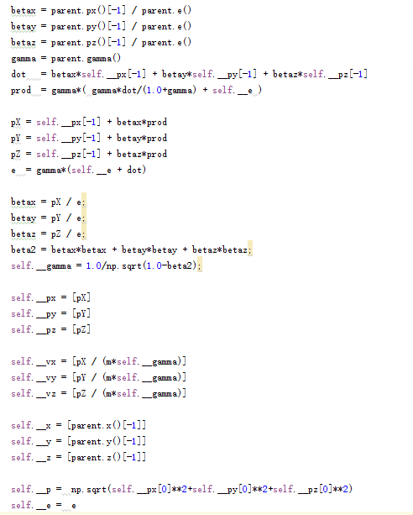
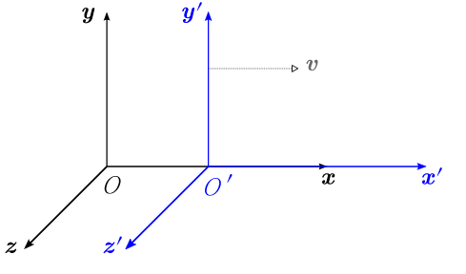
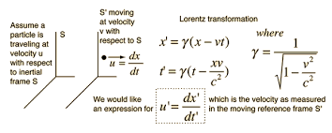
Lorentz Boost

Slide 5
Decay Chain
simulation is determined by random
the possibility in random function can be modified to perform a more realistical simulation
will produce a pair of parents in the coillision
each parent will decay to two daughter particle
output simulated decaychain for the following steps

Slide 6
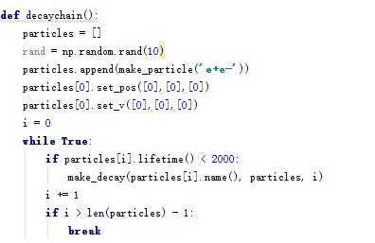
Decay Chain Code

Slide 7
Two Body Decay
get information from duaghter particle produced in previous decaychain function
Based on energy conservation and momentum relaticistically
output:
position, velocity, angles from each axis.

Slide 8
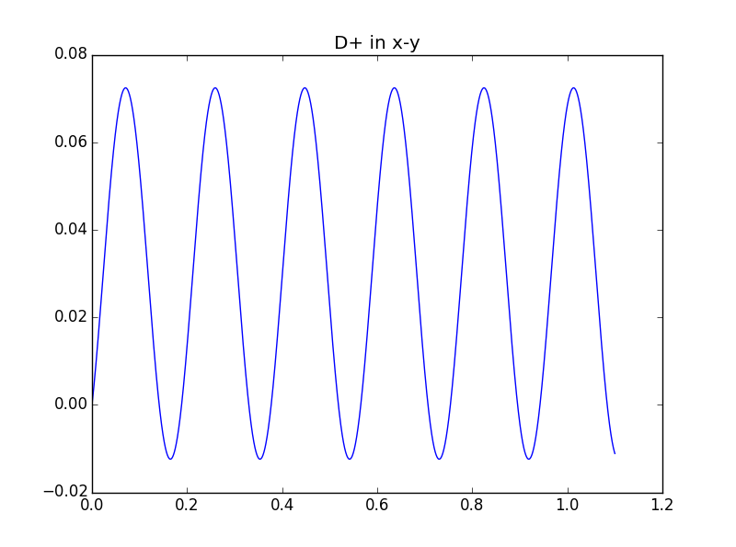
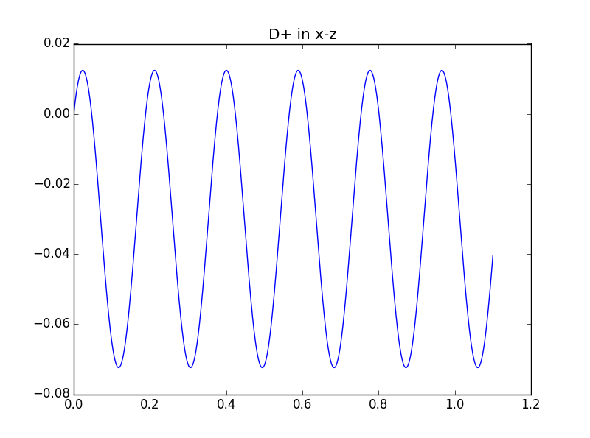
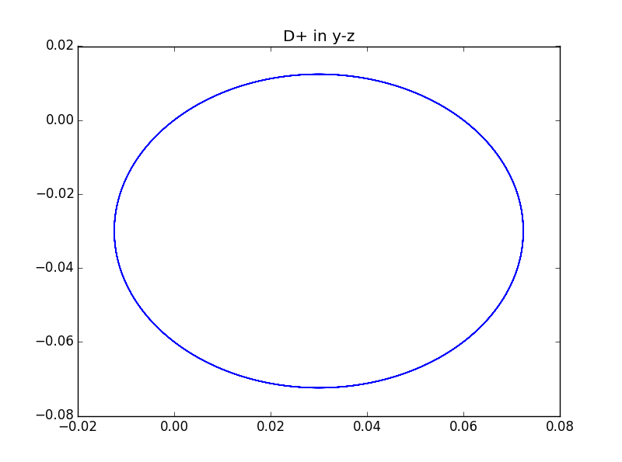
Path & Travel
Assemble Particles information alltogether
plot the x-y, x-z, y-z to illustrate the movement in each cases
B-field is along x axis

Slide 9
Main
Perform a 3-D graph for whole particles movement
illustrate each particles' pathway
output all information get so far:
Decaychain
Mass, Lifetime and Momenta of parents particles
Mass, Lifetime and Momenta of daughters particles
Then end of Decay Chain

Slide 10
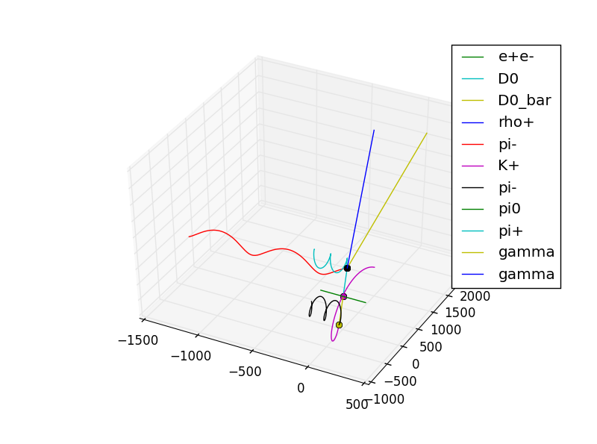
Thanks!

